Slide 1
Password Generator and Automated Login
By Steve Fortuna

Slide 2

Background
Existing password management systems
Free
LastPass
LogMeOnce
Subscription
LastPass - $12/yr
Dashlane - $40/yr

Slide 3
Third Party vs Browser
Third Party
Works with multiple web browsers
Compatible across several devices
Security is first priority
Web Browser
Auto-fill feature
Price
Convenience
Familiarity

Slide 4
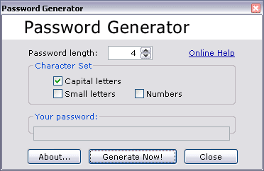

Existing Password Generators
Websites
Pros
Quick and Simple
Cons
Trustworthy
Convenience
Software tools
Pros
Reliable
Accessible
Cons
Cost

Slide 5



Project Overview
Password Generator
Storage of login information
Login Functionality

Slide 6
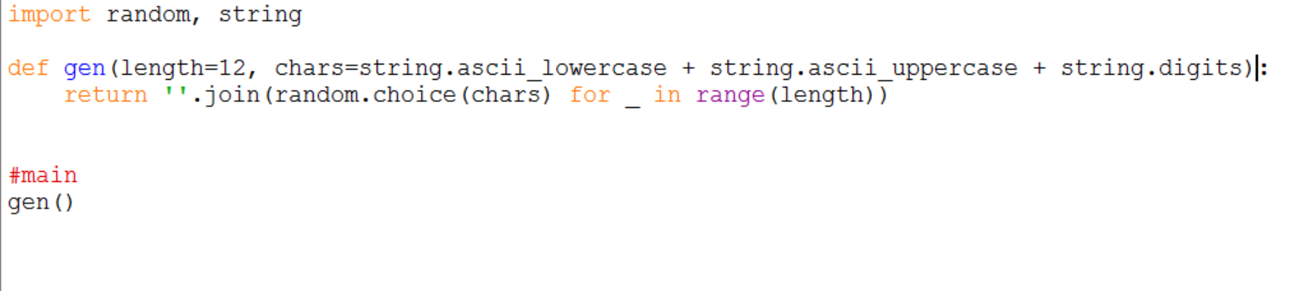
Password Generator
Produces password 12 characters long
Uses lowercase, uppercase & numbers
Utilizes random module to prevent patterns

Slide 7
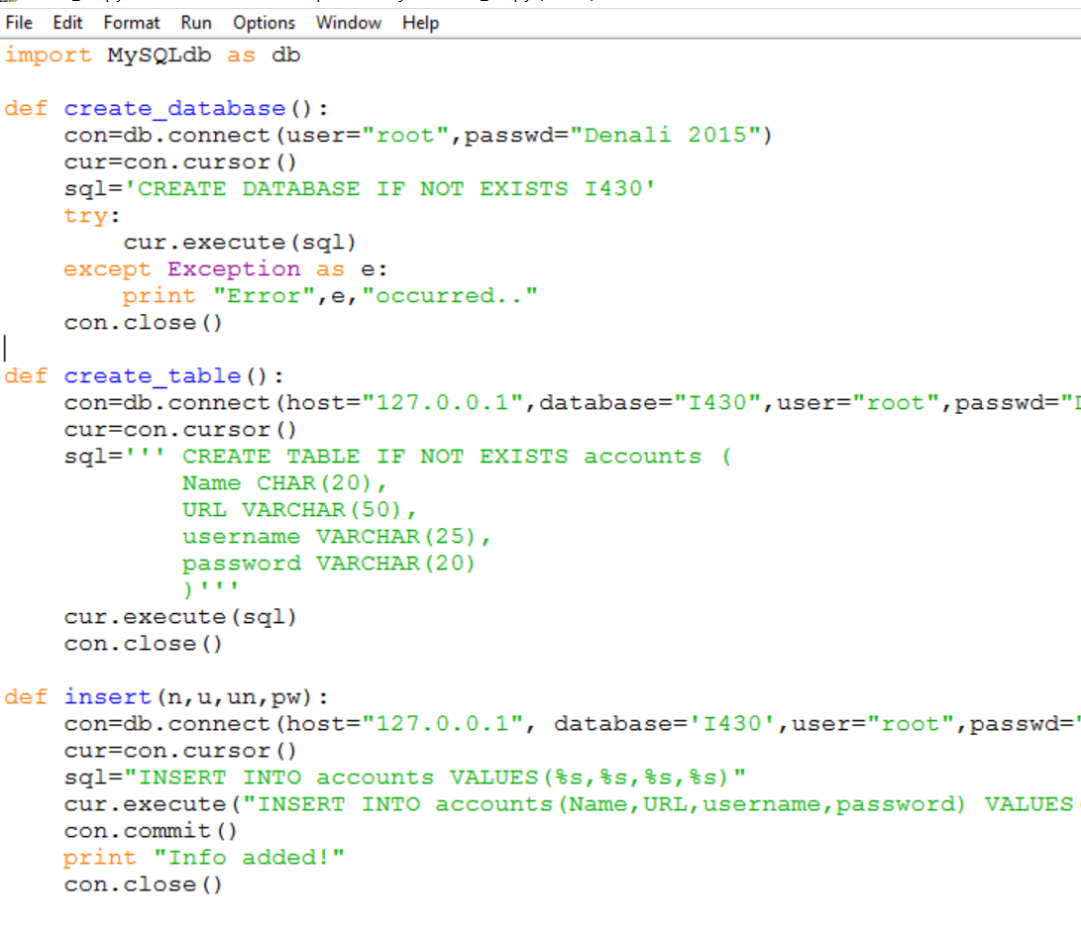
Storage
Create database and table if they don’t exist
Insert name of social media site, url, username and password

Slide 8
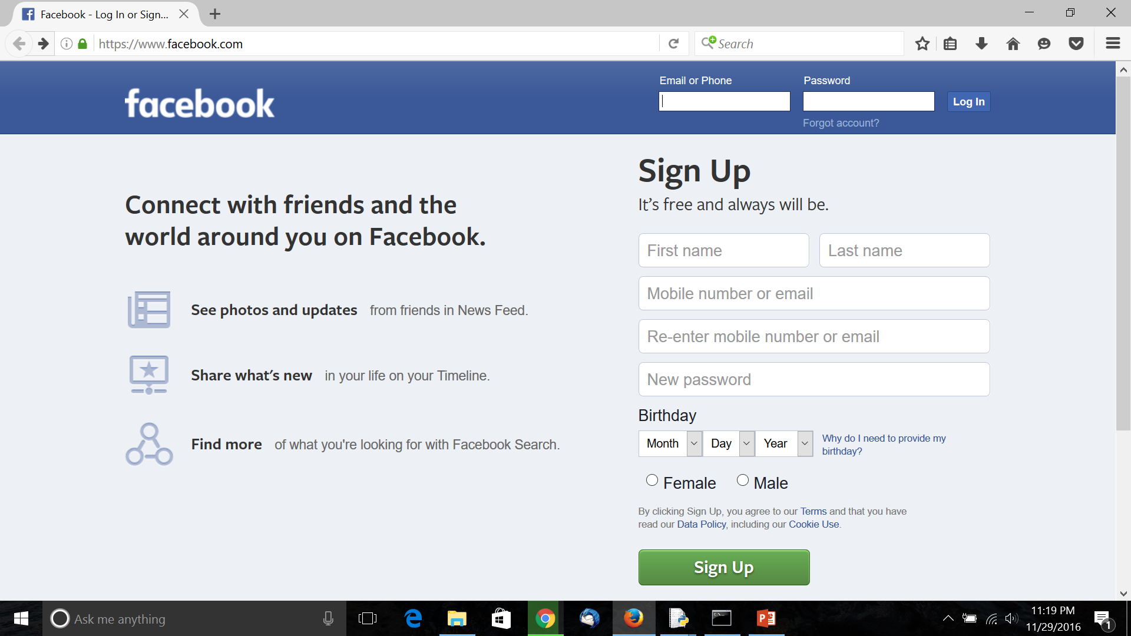
Login Functionality
Create account and store in database
Specify the site you want to login to

Slide 9
Demo

Slide 10
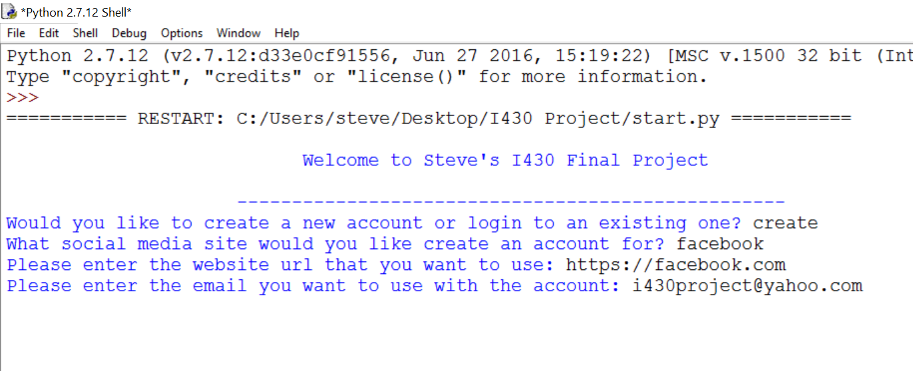
Demo Analysis

Slide 11
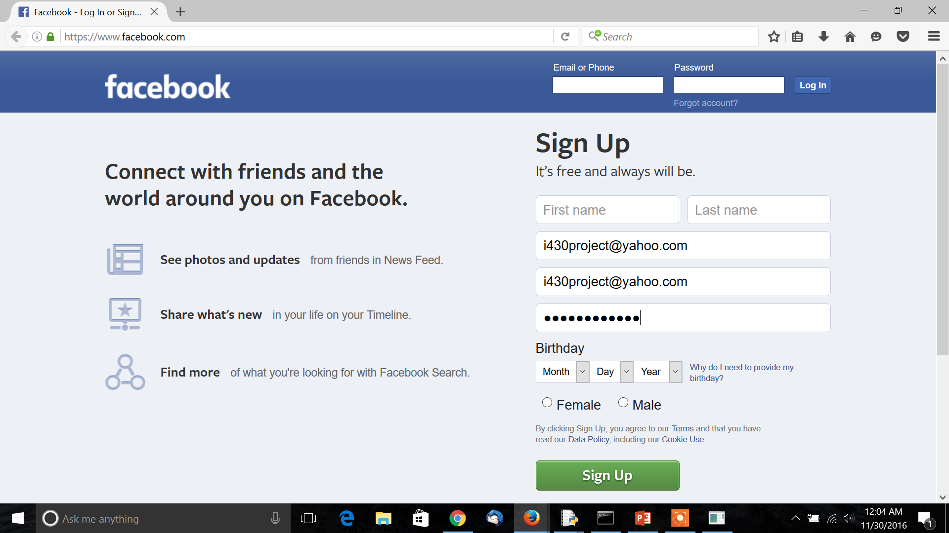
Demo Analysis pt 2

Slide 13
References

